Slide 1
FOE Implementation
Basic Process

Slide 2
FOE IMPLEMENTATION PROCESS FLOWCHART

Slide 3
FOE Implementation
Process Flowchart
The FOE Focal Point is selected for every Area to assist in the implementation of the FOE Program and compliance to the requirements.
FOE Implementation
Process Flowchart

Slide 4
FOE AREA
CONTROL LEVEL ASSESSMENT

Slide 5
FO Control Level Assessment
Complete General Information about the area
Get minimum Control Level from Requirements
Identify Potential FOD Risks to the Product
Identify any additional FOD controls that will used beyond the Requirements and identify any exceptions
Provide any instructions for FOD prevention that are special to the hardware
List the Approvals of the Assessment as required. Examples are FOE Focal Point, Section Manager, Engineering, Program Manger

Slide 6
FO Control Level Assessment
Overall Approach
Complete a FO Control Level Assessment for the area first to determine FOE Control Level of the overall area (baseline).
  This level is noted on the external area signage board
  This assessment should handle all hardware and operations that you would normally expect to process and perform.
  Revise assessment as required (add rev letter – DO NOT OVERWRITE any assessments).
For cases of hardware or processes that do not fit into the overall area assessment performed above, generate an additional assessment to specifically address that hardware or process and understand the FO Control Level required as well as list any special instructions/exemptions.
Area Level Assessment
(Baseline)
Additional Assessments

Slide 7
FOD METRICS

Slide 8
FOD Incident Reporting Metric
Definitions:
Foreign Object Debris | FOD | A substance or article alien to the product or assembly that has the potential to cause damage or degrade the product’s required safety and/or performance characteristics.
Foreign Object Damage | FOD | Any damage attributed to a foreign object that can be expressed in physical or economic terms which may or may not degrade the product’s required safety and/or performance characteristics.
FOD Incident |  | An Instance where Foreign Object Damage or Debris (FOD) is found

Slide 9
FOD Incident Reporting Metric
Standard Reporting Metric (Must be updated monthly and posted):
Example

Slide 10
FOD Incident Reporting Metric
FOD Metric Chart Input Data Table (Example Only):
Manually loaded using data from monthly data sheets
Can automate for a specific area if desired

Slide 11
FOD Incident Reporting Metric
FOD Metric Monthly Data Sheet (Example Only):

Slide 12
FOE CONTROL AREA
IDENTIFICATION

Slide 13


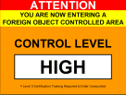
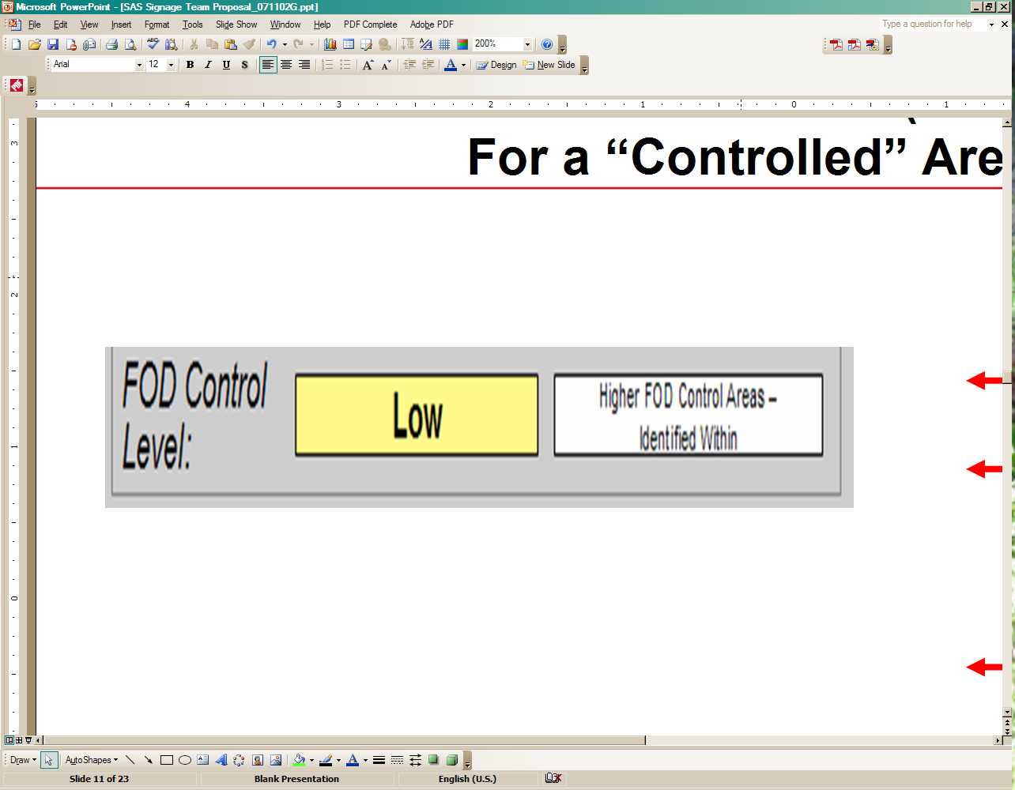
FOE Control Areas
Required for FOE Control Levels different from posted level on signage (for Higher or Lower Areas)
Use signage, floor markings and/or stanchions to identify area
Sub-Areas
Overall Area
LOW
Medium
Example
High
Apply Note for Sub-Areas
Overall Area
Medium
FOE Focal Point is responsible to ensure proper area identification

Slide 14
FOE Control Area
Possible Concerns
Other users working in the Area may not know enough about FOD control levels yet to notify the FOE Focal Point or other Area personnel when a higher (or lower) level of control is needed
It is important that we educate the users to ensure understanding and compliance to the new FOE policy/work instruction at all times
The FO Control Level Assessment should capture the possibility of requiring a Control Level change to accommodate a configuration change (planned or unplanned) with the product

Slide 15

Internal Signage
Example

Slide 16
DAILY FOE AREA SWEEP CHECKLIST

Slide 17
FOE Area Sweep Checklist
FOE Focal Point performs or assigns task
Must be performed daily for all Medium and High areas
Elements may be combined with area 6S program (if performed daily)
Records must be retained
Anything found must be fixed or addressed on the checklist
Template and sweep elements may be tailored to a specific area

Slide 18
MONTHLY FOE SELF-ASSESSMENT CHECKLIST

Slide 19
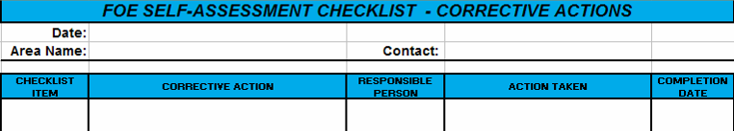
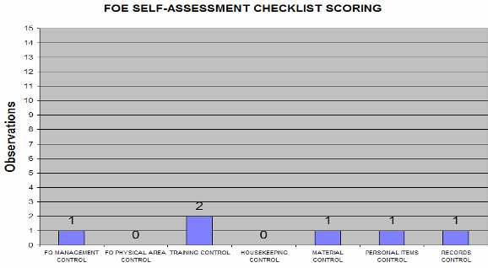
FOE Self-Assessment Checklist
FOE Focal Point performs or assigns task
Must be performed monthly for all Medium and High
Records must be retained
Anything found must be addressed on the Corrective Actions sheet
Template and self-assessment elements may be tailored to a specific area
Impractical to do for temporary Medium/High areas unless area is in place at time of assessment
No requirement to post the self-assessment checklist Pareto chart as a Metric

Slide 20
MATERIAL CONTROL

Slide 21
Material Control
Required for FOE control Levels Medium and High
Try to make Material Control area as small as possible
Use floor markings or stanchions to identify area
Log in/Log out guidelines
Requirement was developed primarily for screws, nuts, bolts, q-tips and other small parts instead of glues, paints and sealants
Make Log in/Log out sheet that is
specific to the operation
Consumables too large to be lost
or impractical to count can be
accounted for using visual
confirmation (examples include
Kimwipes, tape, glue)
Example
Material Control will be the hardest to do!

Slide 22
TOOL CONTROL

Slide 23
Tool Control
Required for FOE control Level of High only
Try to make Tool Control area as small as possible
Use floor markings or stanchions to identify area
Shadowboxing is best method but it may not be practical in an Engineering Lab
Controlled Perimeter List is the easiest to implement
Lost tools must be reported immediately
Controlled Perimeter Tool Checklist:
Recommended Form - May be Tailored to Site/Area Specific Requirements

Slide 24
FOD
INCIDENT REPORTING

Slide 25
Incident Reporting
Follow the FOD Incident Reporting Process Flowchart
All FOD Incidents are required to be reported
Know the definition of FOD to avoid unnecessary reporting
Report a metric for every FOD Incident
Share information with others
Don’t be afraid to report an Incident (root cause analysis is important)
FOE Focal point needs to know about all FOD Incidents
If Foreign Object Damage is found, stop work on the hardware, report incident and initiate an investigation. Resume work when authorized

Slide 26
Incident Reporting
FOD Incident Reporting Process

